Slide 1
Empower your Helpdesk Turn Scripts into Dynamic Webforms
Christian Ritter
@HCRitter | linktr.ee/HCRitter

Slide 2


Slide 3

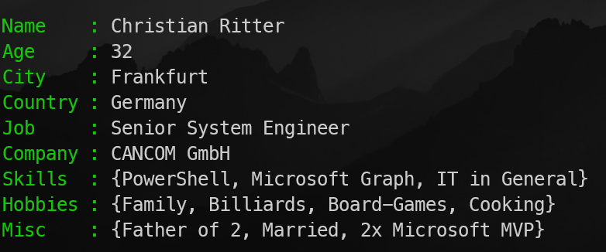
Get-Speaker

Slide 4

Anatomy of Help Desk Scripts

Slide 5
<Parameters>
Provided from the support engineer
<Validation & Testing>
Is everything reachable, inputs valid, etc.
<Execution>
Everything will be processed, like user creation etc.
<Result> Feedback for support engineer, errors etc.

Slide 6
<Parameters>
Provided from the support engineer
<Validation & Testing>
Is everything reachable, inputs valid, etc.
<Execution>
Everything will be processed, like user creation etc.
<Result> Feedback for support engineer, errors etc.

Slide 7
<Parameters>
Provided from the support engineer
Parameter block inside of the function, needs to be exported via AST
<Validation & Testing>
Is everything reachable, inputs valid, etc.
<Execution>
Everything will be processed, like user creation etc.
<Result> Feedback for support engineer, errors etc.

Slide 8
<Parameters>
Provided from the support engineer
<Validation & Testing>
Is everything reachable, inputs valid, etc.
<Execution>
Everything will be processed, like user creation etc.
<Result> Feedback for support engineer, errors etc.

Slide 9
<Parameters>
Provided from the support engineer
<Validation & Testing>
Is everything reachable, inputs valid, etc.
Begin block inside of the function, feedback needs to be visible
<Execution>
Everything will be processed, like user creation etc.
<Result> Feedback for support engineer, errors etc.

Slide 10
<Parameters>
Provided from the support engineer
<Validation & Testing>
Is everything reachable, inputs valid, etc.
<Execution>
Everything will be processed, like user creation etc.
<Result> Feedback for support engineer, errors etc.

Slide 11
<Parameters>
Provided from the support engineer
<Validation & Testing>
Is everything reachable, inputs valid, etc.
<Execution>
Everything will be processed, like user creation etc.
Process block inside of the function, errors needed to be collected
<Result> Feedback for support engineer, errors etc.

Slide 12
<Parameters>
Provided from the support engineer
<Validation & Testing>
Is everything reachable, inputs valid, etc.
<Execution>
Everything will be processed, like user creation etc.
<Result> Feedback for support engineer, errors etc.

Slide 13
<Parameters>
Provided from the support engineer
<Validation & Testing>
Is everything reachable, inputs valid, etc.
<Execution>
Everything will be processed, like user creation etc.
<Result> Feedback for support engineer, errors etc.
End block inside of the function, return result of the execution to the support engineer

Slide 14
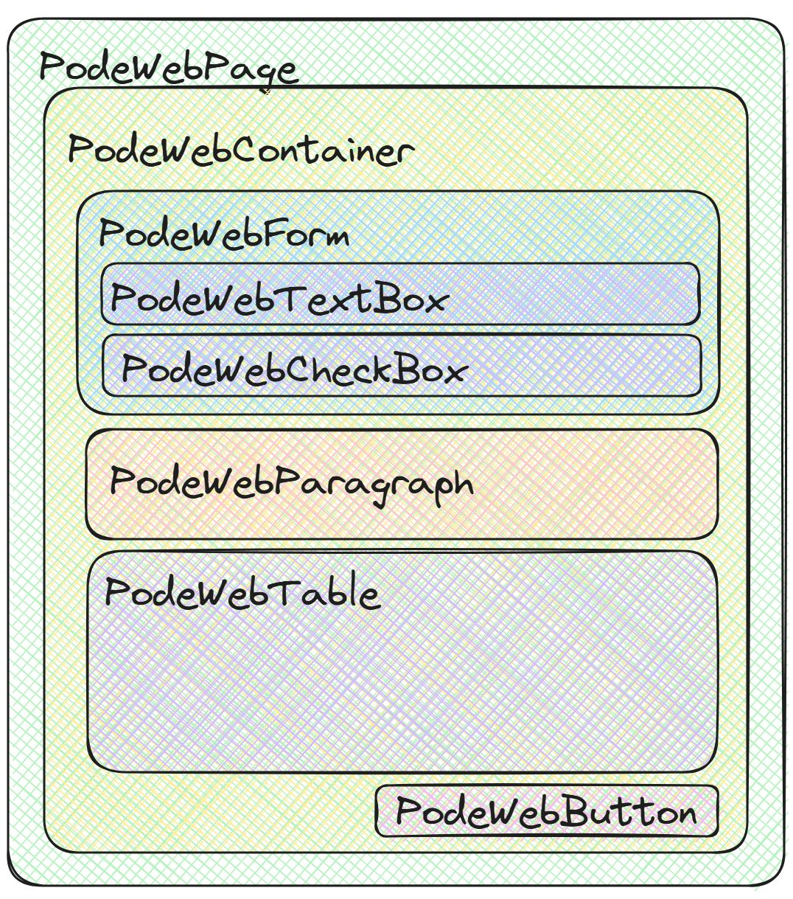
Anatomy of a Pode.Web Site

Slide 16



What`s wrong with you?

Slide 17
What parameters does my Script have?

Slide 18
(Initial Patient Consultation) = AST Analysis of Script Parameters

Slide 19
Tests don`t lie, people do.

Slide 20
Lab Tests & Diagnostics = Log File & Script Execution

Slide 21
Prescribing Medication with Dosage Adjustments = Role Separation
1st Level gets only mild painkillers (basic scripts).
2nd Level can work with stronger medication (more scripts).
Only the “Chief Doctor” (3rd Level) can prescribe everything (execute all scripts).

Slide 22
It`s never Lupus, but it`s always a permission issue. Or DNS

Slide 23

Demo Time

Slide 24

THANK YOU
Feedback is a gift. Please review this session

